Slide 1

Predictors of Pregnancy Risk
Alexis Rojas Larissa Fierle Natalie Lopez Maria Villacreces

Slide 2
Introduction
Our research aims to identify the key indicators that influence risk levels during pregnancy. We are using a dataset taken from various hospitals, clinics and maternal health care centers in Bangladesh, India. Our primary focus is analyzing age, blood pressure, heart rate, and blood sugar to determine their impact on predicted risk intensity level of pregnancy complication.

Slide 3
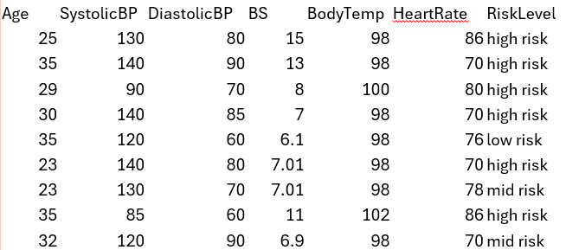
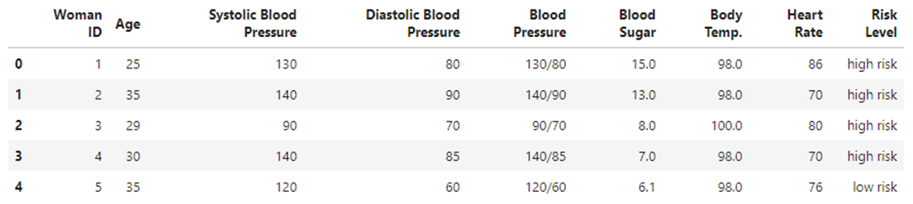
Maternal Health Data
Raw data collected from .csv file
Organized DataFrame created in Jupyter Notebook

Slide 4
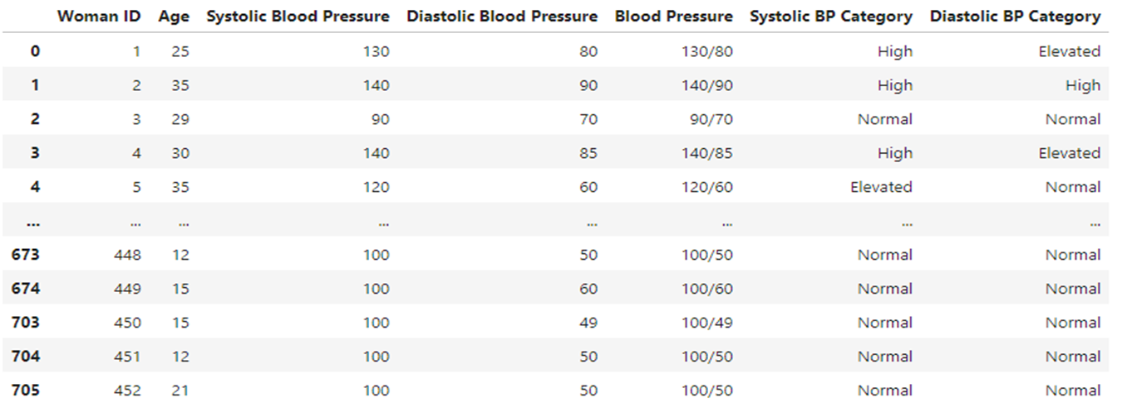
Blood Pressure Vs. Risk Level
How much blood pressure is safe during pregnancy?
Hypothesis: Women who have a high blood pressure are at a higher risk than women who are within the normal blood pressure range.

Slide 5
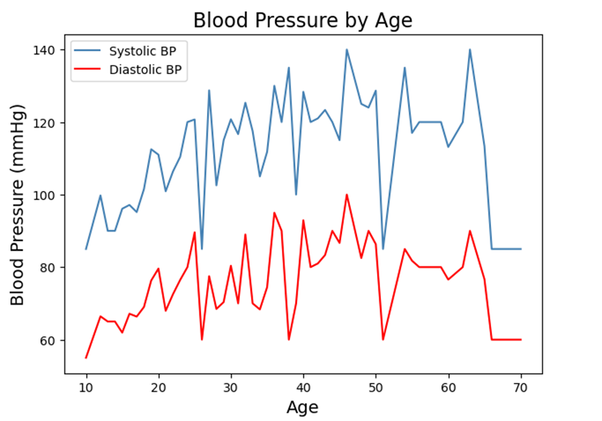
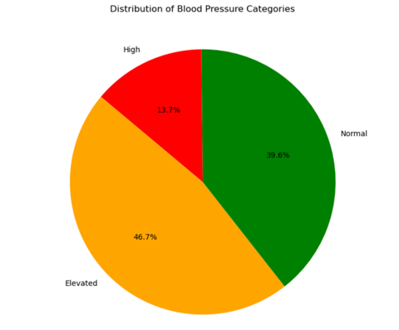
That graph visually represents how blood pressure changes with age. Both lines show an upward trend.
This pie chart depicts the distribution of blood pressure categories and how it breaks down the proportion of a population within each blood pressure range.

Slide 6
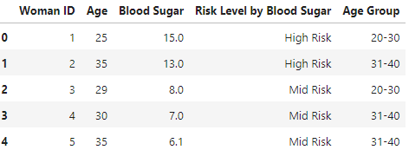
Blood Sugar Vs. Risk Level
How do Blood glucose levels (mmol/L) affect the risk level during pregnancy?
Hypothesis: Elevated blood glucose levels in pregnant women are associated with an increased risk of complications, categorizing the pregnancy as higher risk.

Slide 7
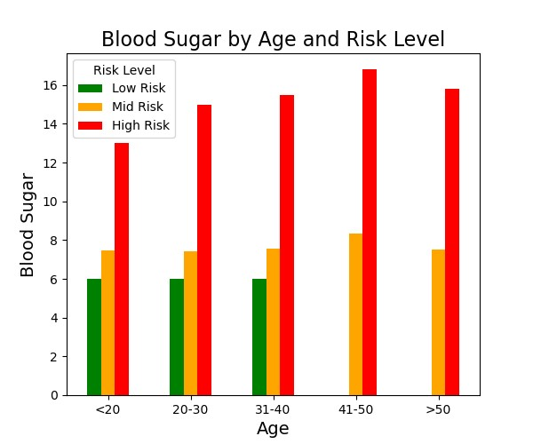
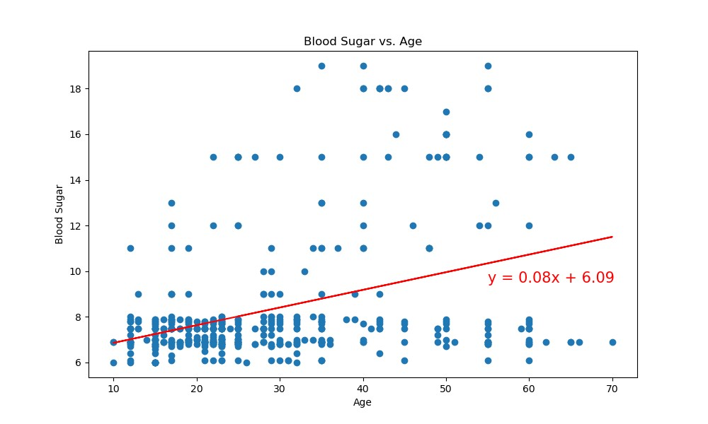
The bar graph illustrates blood sugar levels across different risk categories- Low Risk, Mid Risk, and High Risk segmented by age.
As age increases, there's a pattern where blood sugar also tends to increase in mid and high-risk categories.
The scatter plot with the regression line described by the equation y= 0.08x + 6.09 showcases a linear relationship between age and blood sugar. The positive slope indicates a gradual increase.

Slide 8
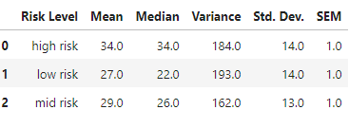
Age vs. Risk Level
How does age correlate with the risk level?
Hypothesis: The age of a woman significantly influences her risk level during pregnancy, with specific age groups showing a higher chance.

Slide 9
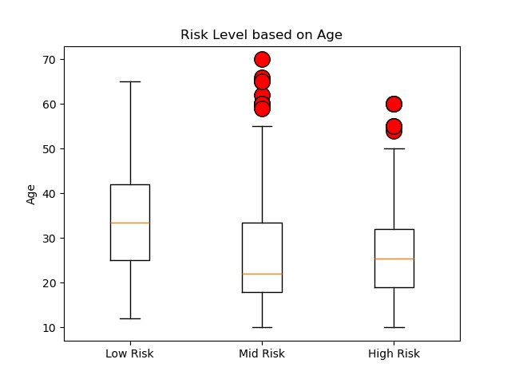
Risk Level: Low Risk The upper quartile of age is: 33.5 The lower quartile of age is: 18.0 The interquartile range of age is: 15.5 Values below -5.25 could be outliers for risk level low risk. Values above 56.75 could be outliers for risk level low risk. | Risk Level: Mid Risk The upper quartile of age is: 32.0 The lower quartile of age is: 19.0 The interquartile range of age is: 13.0 Values below -0.5 could be outliers for risk level mid risk. Values above 51.5 could be outliers for risk level mid risk. | Risk Level: High Risk The upper quartile of age is: 42.0 The lower quartile of age is: 25.0 The interquartile range of age is: 17.0 Values below -0.5 could be outliers for risk level high risk. Values above 67.5 could be outliers for risk level high risk.

Slide 10
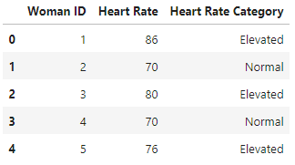
Heart Rate Vs. Risk Level
Does a pregnant woman’s heart rate predict her pregnancy risk level?
Hypothesis: The resting heart rate of a woman during pregnancy correlates with the risk level of the pregnancy. Certain heart rates could suggest whether her pregnancy is at a higher or lower risk.

Slide 11
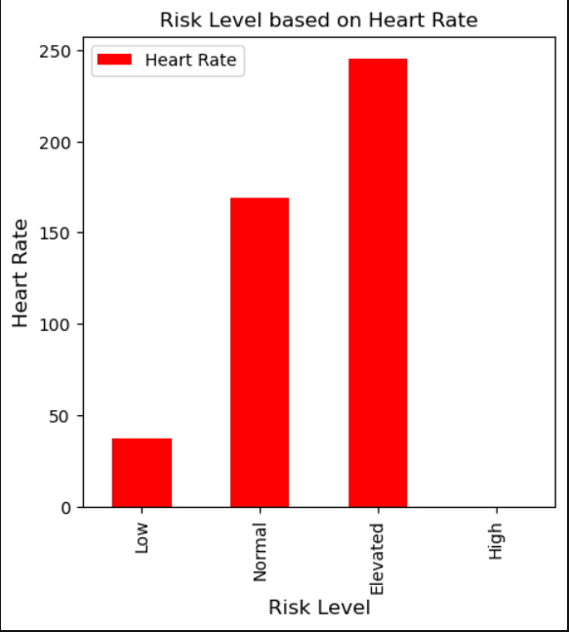
The bar graph illustrates a relationship between a woman's heart rate during pregnancy and the risk levels of her pregnancy.

Slide 12
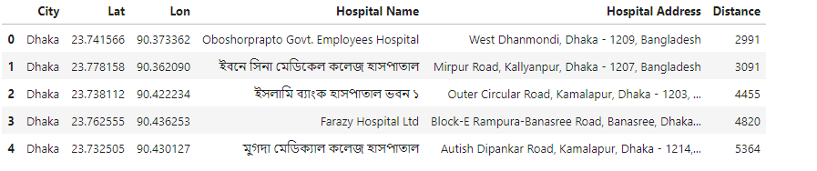
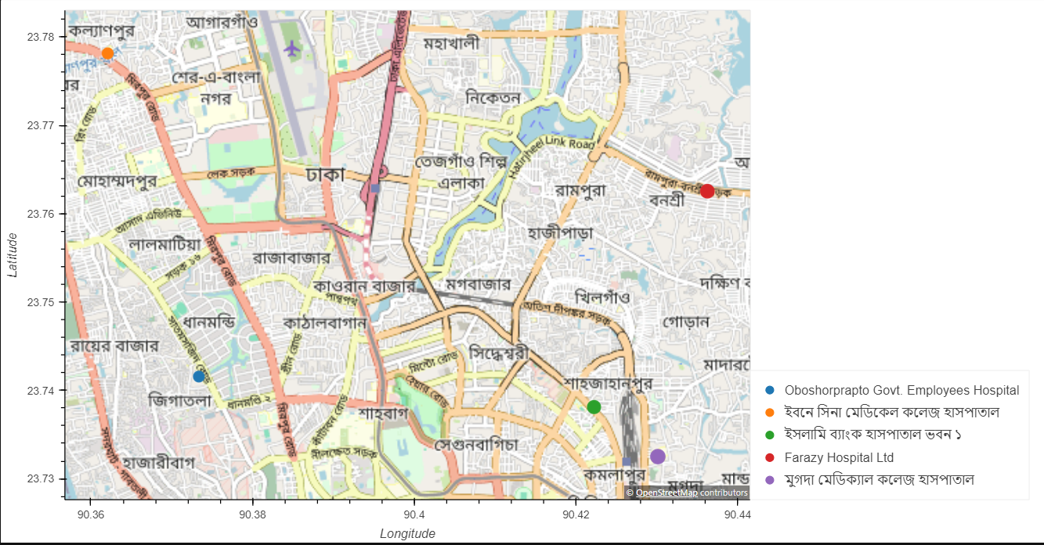
Geoapify

Slide 13
Conclusion
Our study found blood pressure to be the strongest indicator of pregnancy risks, surpassing age, heart rate, and blood sugar.
The importance of managing blood pressure is shown by our significant findings, with a p-value of 1.39e-23, indicating a strong relationship between blood pressure and pregnancy risk levels.
Overall, this highlights the necessity of prioritizing blood pressure monitoring to ensure the safety of both the mother and child during pregnancy.

Slide 14
References:
https://www.kaggle.com/datasets/csafrit2/maternal-health-risk-data/data
https://www.medicalnewstoday.com/articles/normal-blood-pressure-pregnancy
https://drkumo.com/normal-blood-sugar-levels-chart-for-pregnancy/

